Slide 1


Electrostatic Discharge and Grounding Network

Slide 2



Implications of Poor Operational Practices
Poor Customer Experience
Frequent system downtime
Long repair time
Slow availability of new function
Higher OPEX Costs
Delayed benefits of innovation
Lack of flexibility
Function duplication
Manual processes
Increased Unquantifiable Risk
Unforeseen vulnerabilities
Security breaches
Data loss

Slide 3
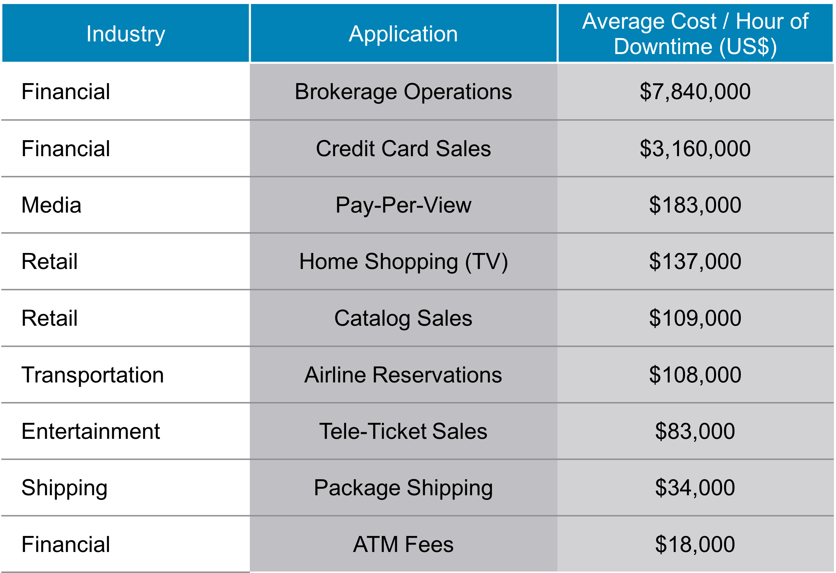
High Availability – Average Cost of Impact

Slide 4
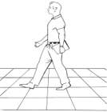
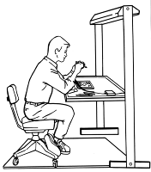
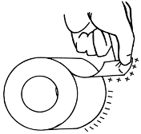
Large ESD Charges Are Generated By:
Types of ESD Damage to Electronic Products
Catastrophic: Sudden and complete crash of the system
Cumulative: Device failures / silent failures
Latent: Failure over time
Walking across inadequate carpet material:
1,500 - 35,000 volts
Walking over untreated vinyl floor:
250 - 12,000 volts
Handling a vinyl envelope:
600 - 7,000 volts
Worker at an ungrounded bench:
700 - 6,000 volts
Unwinding regular tape:
9,000 - 15,000 volts

Slide 6


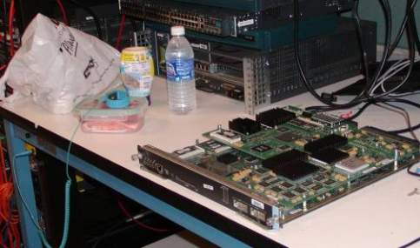

Electrical Current Types
First Type:
Current flows easily from / to metals and people
Can be grounded
Second Type:
Electrical current does not flow easily
Plastics CANNOT be grounded
Typically very high charging

Slide 7

Cisco Recommendations to Manage ESD and Secure Proper Grounding Installation
Step by Step Cisco Best Practices

Slide 8





Define the Areas Where Network Products Are Handled or Installed
1
Store
Inspect
Network Operations Center
Receive

Slide 9
Identify Control Level Based on Level of Potential Exposure
2
Store
Mid Level II
Inspect
Network Operations Center
Receive
Mid Level II
Low Level III
High Level I
High Level I
Mid Level II
Low Level III

Slide 10
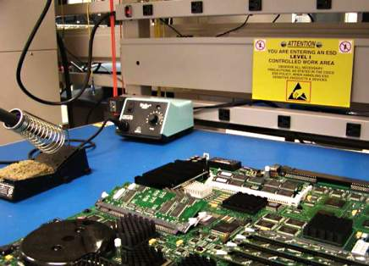
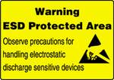
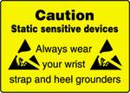
Use Appropriate Symbols to Identify Areas Where Sensitive Items Will Be Handled
3
Network Operations Center
Network Operations Center
High Level I
High Level I

Slide 11
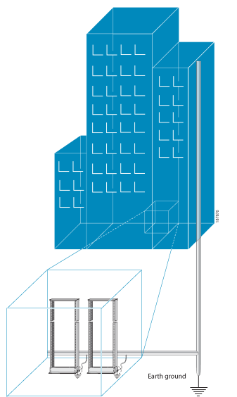
Prepare the Location – Make Sure the Building is Properly Grounded
4
Earth Ground

Slide 12
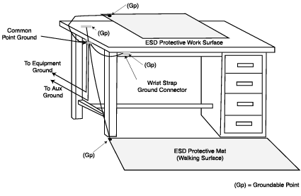

Ground Work Stations Where Network Products Are Physically Handled
5
Ground Point
Ground Point
Ground Point
Ground Point
High Level I

Slide 13
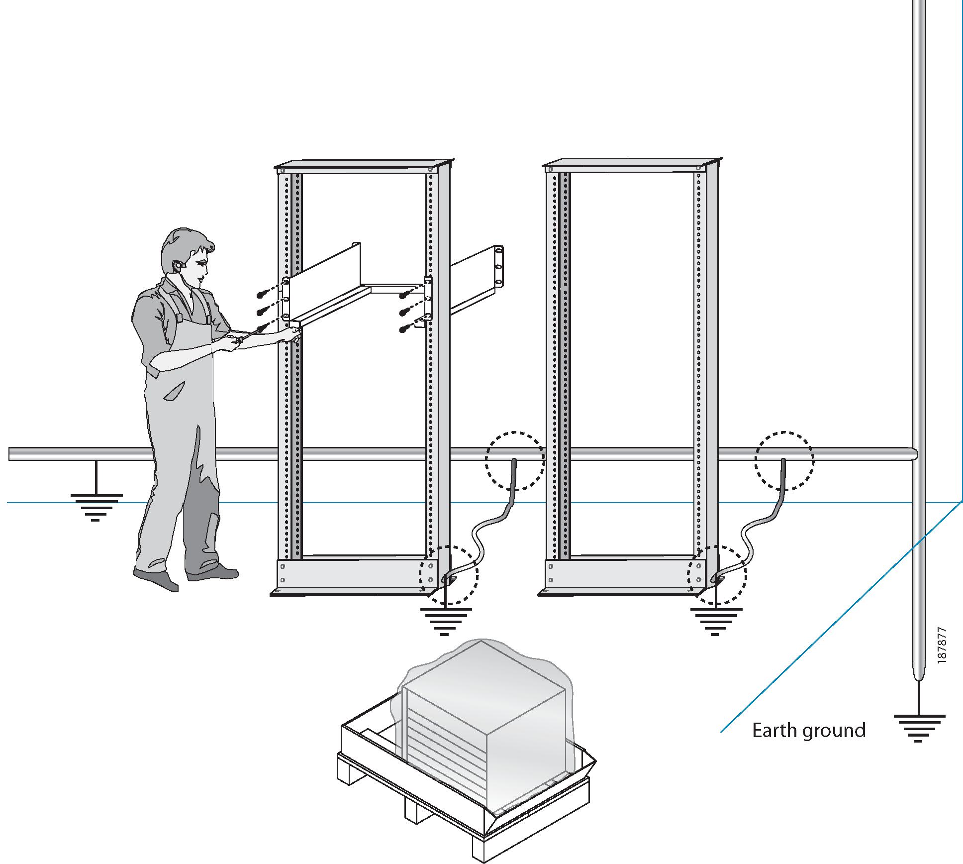
Prepare Rack Room – Connect Properly to Earth Ground
6
Earth Ground
High Level I

Slide 14

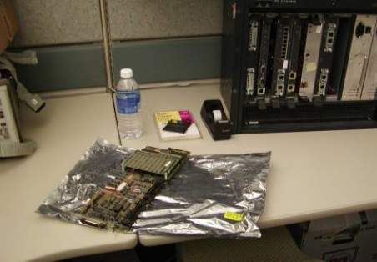
Ground Work Stations Areas When Physically Handling Network Products
7
Example of Good (check mark) workstation
High Level I

Slide 15
Ground Network Products According to Product Documentation Instructions
8
A - Grounding in an electronic equipment room with an existing grounding grid beneath the floor
Building Steel Columns
Power Center
Network Product
Welded – Bounding Strap
Fake- Upper Floor
Grounding / Signal Reference Grid
Always

Slide 16
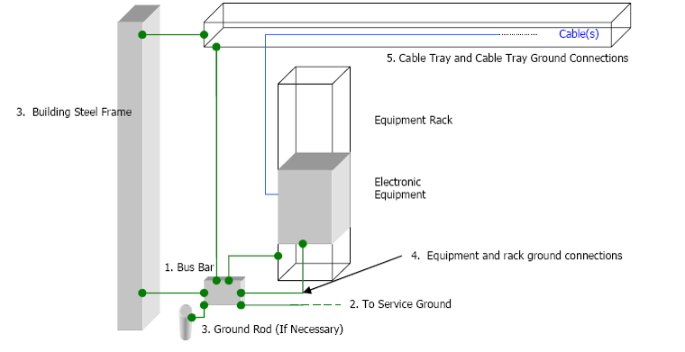
Ground Network Products According to Product Documentation Instructions
9
B - Grounding in an electronic equipment room without an existing grounding grid beneath the floor
Always

Slide 17





Use Resistive Grounding and Insulating Materials
10
100% Cotton
Wheels
Wrist Strap
Foot Strap
High Level I
Mid Level II

Slide 18
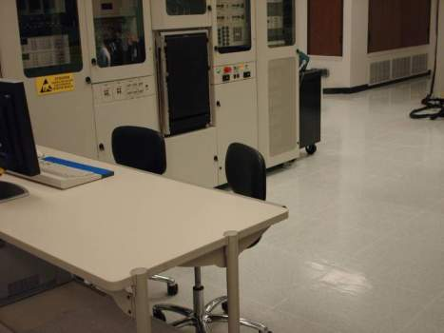
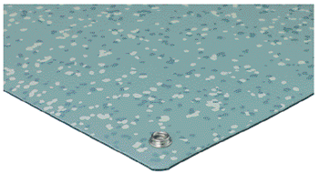
Provide Appropriate Ground Paths to Avoid Generation and Accumulation of Static
11
High Level I
Floor mats / floor finishes -insulating floor

Slide 19
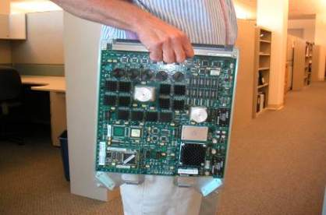
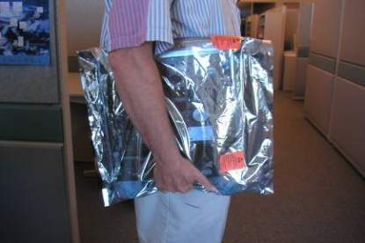
Always Carry Sensitive Items Inside ESD Bags
12
High Level I
Always
Mid Level II
Low Level III

Slide 20
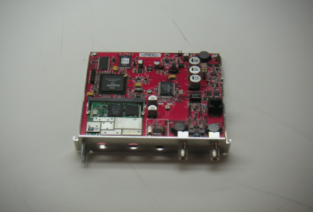
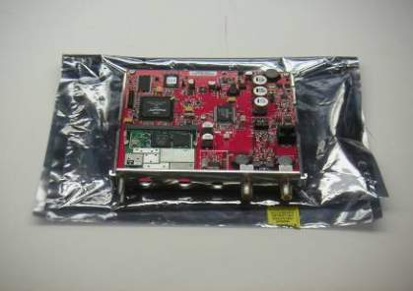
Always Place ESD-Sensitive Items on a Protected ESD Surface
13
High Level I
Mid Level II
Protected ESD mat
Always
Low Level III

Slide 21
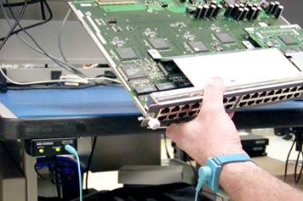
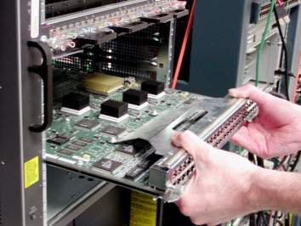
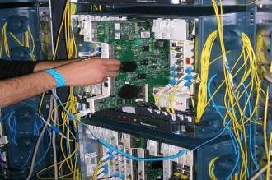
Touch ONLY If You Are Grounded or Your Body Static Charge Has Been Neutralized
14
High Level I
Mid Level II
Low Level III
Always

Slide 22
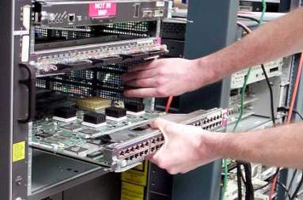
Touch ONLY If You Are Grounded or Your Body Static Charge Has Been Neutralized
15
High Level I
Always
Mid Level II
Low Level III

Slide 23
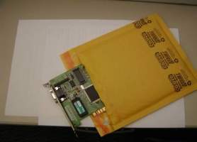
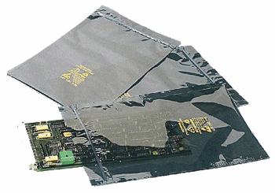
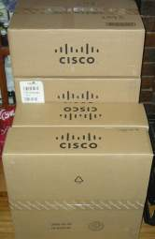
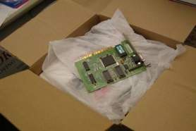
To Store or Ship, Always Pack Inside ESD Bags and Corrugated Product Boxes
16
High Level I
Mid Level II
Low Level III
Always

